Slide 1
Software Project Management
In the name of Allah, the Beneficent, the Merciful
Lecture 00:
Course Introduction

Slide 2
Course Overview
This course gives you the overview about:
What Software Project Management actually is?
What tools and techniques you will use to manage your project.
Similarly, all about the risk management, quality assurance activities, and project planning, scheduling activities will be covered in this course.

Slide 3
Course Goal:
Goal of this course is to provide the student with principles, processes and practices associated with the management of software intensive projects

Slide 4
Objectives:
Understand the importance of project management in software development and get started with project management fundamentals
Plan the small to medium scale project
Define the scope of small scale projects
Schedule the small scale projects
Estimate the cost of small scale projects
Understand the importance of Communication and Communicate to all concerned stakeholders
Understand and Perform risk management and adjust project plans
Learn to manage the Quality, Project Changes, Human Resource and Procurement issues
Use and application of tools to facilitate the software project Management process (e.g. Microsoft Project)
Understand the formalities of closing the project

Slide 5
Makeup Policy
No makeup for assignment, quizzes, presentations or exam – No exceptions.

Slide 6
Class Participation
Behavior
Punctuality
Seriousness
Self Learning
Knowledge Sharing
Team Work /Collaboration
Research Articles
Class Activities

Slide 7
Zero Tolerance of Cheating
Any form of cheating will earn you Negative Marks.
This policy will be applied to all students involved in the incidence - Including those whose material was copied
By remaining enrolled, you consent to this policy.

Slide 8
Students are Expected:
To come to class on time.
To be attentive and engaged in class.
To refrain from using cell phones and similar electronic devices during class.
To spend an adequate amount of time outside the class to understand various concepts, techniques, content, etc.
To seek help when appropriate.

Slide 9
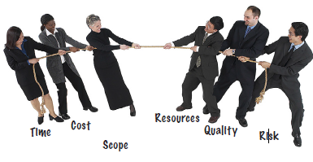
What do you think?

Slide 10
Software Engineering Process
Requirements Engineering
Analysis
Design
Coding
Testing
deployement

Slide 11
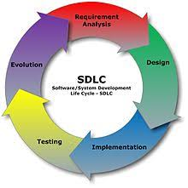

Slide 12
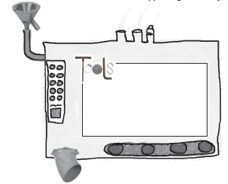
The Process Framework:
First you plan it thoroughly
then you get to work
While you are doing the work, you are always comparing your project to your original plan
When things start to get off-plan, it’s your job to make corrections and put everything back on track.

Slide 13

What is PMI and the PMP?
The Project Management Institute (PMI) is the world’s largest membership association for the advocacy of Project and Program management.
Over 600,000 PMI certification holders
Their most widely recognized certification is the PMP (Project Management Professional). The PMP credential recognizes your:
Experience,
Education, and
Competency to lead and manage projects
Earning the PMP credential requires:
A bachelor’s degree and 4,500 hours of documented project management experience, or a secondary degree and 7,500 hours of documented project management experience
35 hours of certified project management training

Slide 14


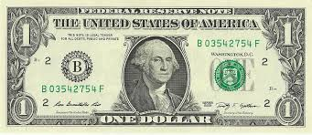

Why Is This Useful to Know?
Project
Initiation
Project
Planning
Project
Execution
Project
Closure
The PMI approach places great emphasis on project initiation and planning when requirements are clearly defined and agreed upon and the full scope of the project is planned

Slide 15
Few PMI Definitions:
PMBOK ® - the Project Management Book of Knowledge from which PMI defines terms, standards, and good practices
Portfolio – Projects, programs, and operations managed as a group to achieve strategic objectives
Program - A group of projects and program activities managed in a coordinated way
Project – a temporary endeavor undertaken to create a unique product, service, or result
Project Management – the application of knowledge, skills, tools, and techniques to project management activities to meet project requirements
Project Manager – the person authorized by the performing organization to direct the team accountable for realizing project objectives
Project Stakeholder – includes all project team members and anyone impacted by or impacting the project
Triple Constraint – the foundation of project management is balancing scope, time, and cost. Quality is at the center of the triple constraint

Slide 16
Software Project Management
Process Groups
Knowledge Areas
Initiating
Planning
Executing
Controlling
Closing
Scope Management
Time Management
Cost Management
Quality Management
Human Resources Management
Communications Management
Risk Management
Procurement Management
Integration Management
Stakeholder Management

Slide 17
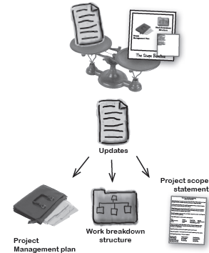
Scope Management:
Doing the right stuff
Confused about exactly what you should be working on?

Slide 18
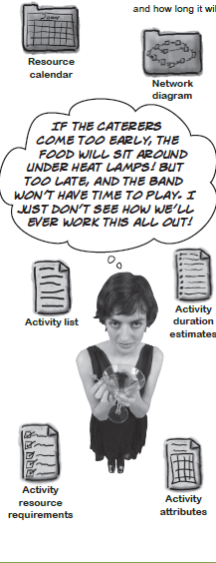
Time Management:
Getting it done on time
Time management is
what most people think of
when they think of project
managers

Slide 19


Cost Management:
Watching the bottom line
Every project boils down to money

Slide 20

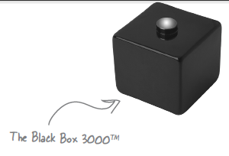
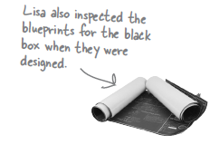
Quality Management:
Getting it right
It’s not enough to make sure you get it done on time and under budget

Slide 21
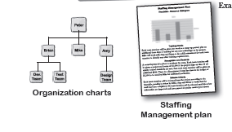

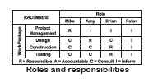
Human Resource Management:
Getting the team together
Behind every successful project is a great team

Slide 22
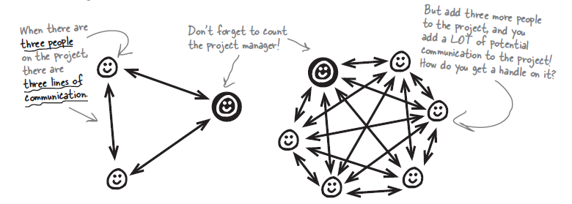

Communication Management:
Getting the word out
Communications management is about keeping everybody in the loop

Slide 23


Risk Management:
Planning for the unknown
Even the most carefully planned project can run into trouble

Slide 24
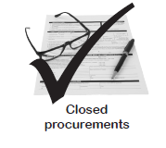
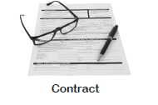
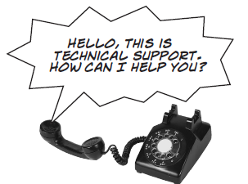
Procurement Management:
Getting some help
Some jobs are just too big for your company to do on its own

Slide 25
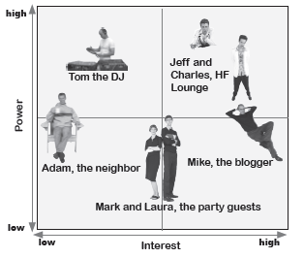
Stakeholder Management:
Keeping everyone engaged
Project management is about knowing your audience

Slide 26
Q & A

